Slide 1
The Bad Boyz

Slide 2
Solving a Word Search
Design and Analysis of Algorithms for
Created in collaboration with students such as:
Chase
Ryan
John
And Austin

Slide 3

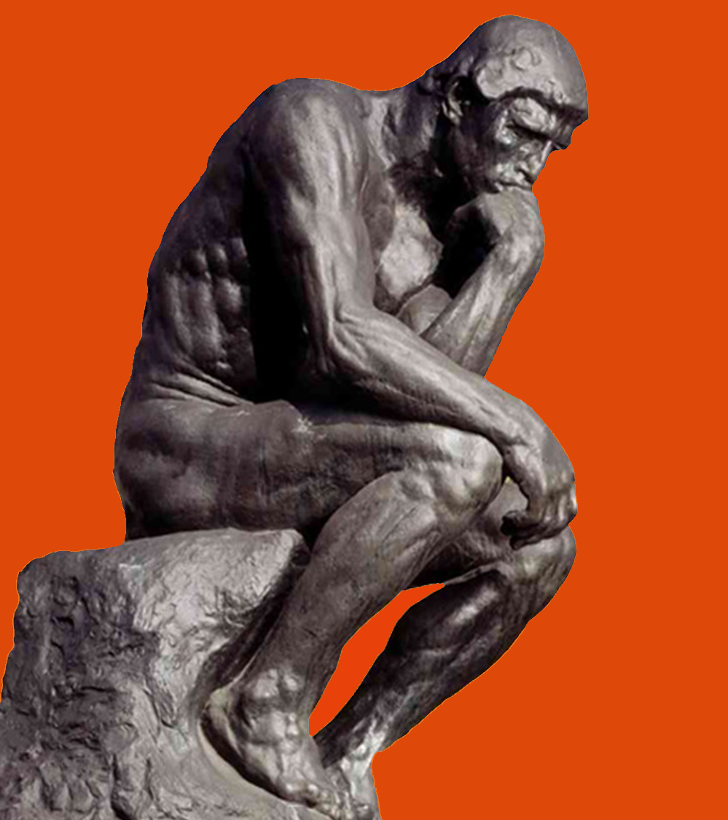
Our Problem
In Natural Language:
Find all words in a given word list within a board of randomly generated characters
Aka Word Search Puzzle

Slide 4
Formal Statement: Variables
B_{i, j} = matrix of letters comprising game board, i & j indicate position
L = List of words to find ex: [w₁, w₂, w₃, … w_{Q}]
W_{i} = a unique sequence of M alphabetic characters in list L
Q = Number of unique words in list L
M = number of characters in a word
N = number of characters in a sequence
S = sequence of characters for any w ϵ W_{L}
D = list of directions
[up, down, left, right, down-left, down-right, up-right, up-left]

Slide 5
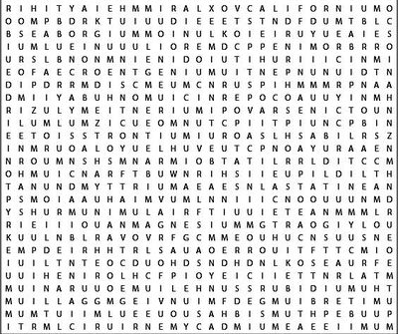

Formal Statement
Alabama
Alaska
Arizona
Arkansas
California
Colorado Connecticut
“For all words W in word list L such that the first character in Word w_{k} exist in the Board B at some given coordinate (i,j)…
{
AND
B
The sequence S_{k} of word w_{k} is equal to sequence S_{o} where S_{o} is all combinations of sequences around B_{i, j}”
W_{L}
If this statement returns true, the word w_{k} exist in board B
{∀ w ϵ W_{L} | (w_{k}[0] B_{i, j}) ∩ (S_{k} = B_{i, j} + (S_{k}-S_{k}[0]) ∀ D_{e} ϵ D | N_{k} = M_{k})} = T/F
This Photo by Unknown Author is licensed under CC BY-NC

Slide 6
Our Algorithms
Brute
Force
Boyer-Moore
Bear Method
Rabin–Karp
Check every spot until the word is found, for every word.
Converts the board to a string and searches for substrings.
Put all letters on the board in hash maps sorted by letter to find words.
Uses string searching and hash maps to find each word in the list.

Slide 7

Why Using 4 Letter Words is Viable
When using shorter words in our tests, we considered the fact that shorter words have a greater chance of appearing randomly on a large board.
Since the likelihood of a four letter word appearing randomly in a 50 by 50 word search is less than a hundredth of a percent, we considered it statistically negligible in the context of our research.
$$50×50=2,500 → \frac{2500}{26}≈96.15 → \frac{96.15}{2500}=0.03846$$
$0.0384×\frac{8}{26}×\frac{1}{26}=0.0004$ or 0.04% for a three letter word
$0.0384×\frac{8}{26}×\frac{1}{26}×\frac{1}{26} =$ 0.000017 or 0.0017% for a four letter word

Slide 8
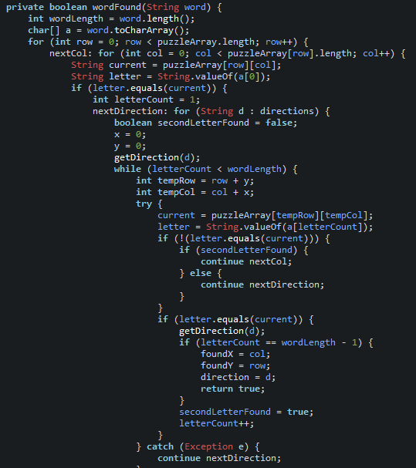
Brute Force
Brute Force checks every possible spot for each word until it is found.
This is obtained naively through the use of four loops with certain conditions, giving it a time complexity of O(n⁴)

Slide 9
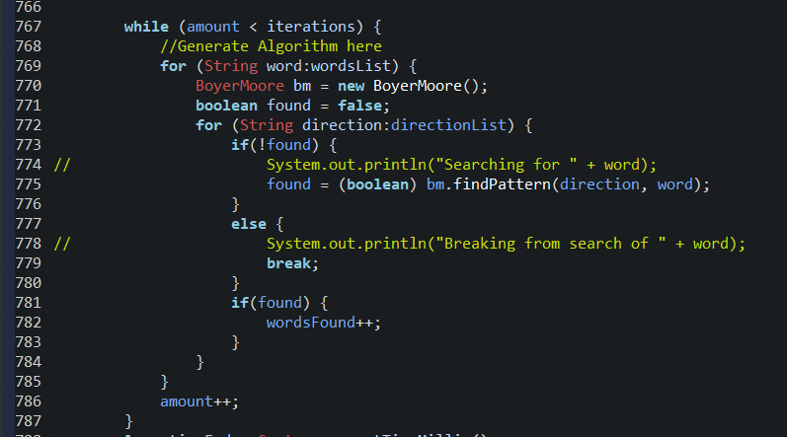
Boyer-Moore
The Boyer-Moore Method relies heavily on pre-processing and converting everything to strings to search for words.
The algorithm employs three loops giving a time complexity of O(n³)

Slide 10
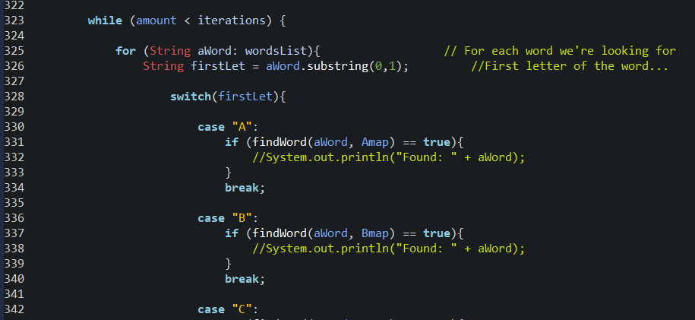
Bear Method
The Bear Method also relies heavily on pre-processing, since it sorts all letters in the board into 26 hash maps based on their letter.
This algorithm employs 4 loops, giving it a time complexity of O(n⁴)

Slide 11
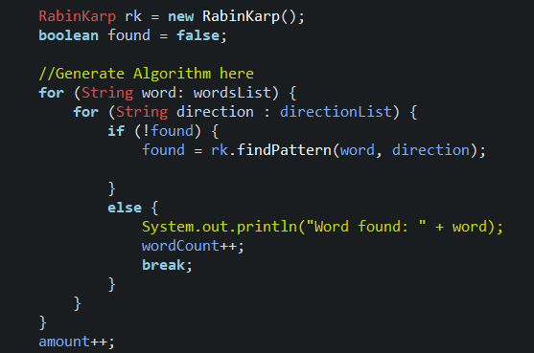
Rabin-Karp
The Rabin-Karp method also relies on pre-processing and converting the board to a string, but in addition, it also uses hash maps.
This method employs three loops giving it a time complexity of O(n³)

Slide 12
Compare All 4 Time Complexities
Brute: O(n⁴) Boyer-Moore: O(n³)
Bear: O(n⁴) Rabin-Karp: O(n³)

Slide 13
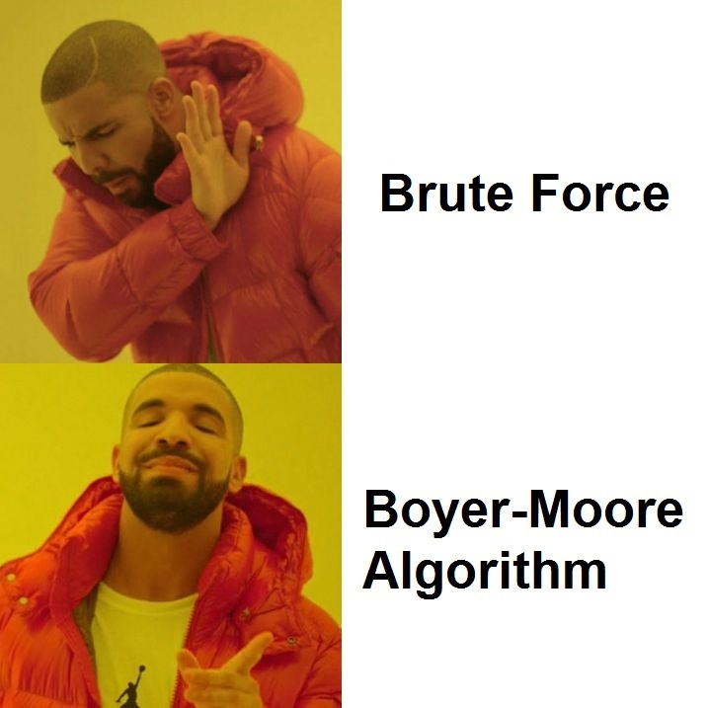
First Hypothesis
We predict…
Boyer-Moore will be the most efficient algorithm when dealing with a larger data set.
That when changing the constraints to our problem, the performance of each algorithm will be affected.

Slide 14
New Hypothesis
With a larger board:
The Brute Force and Bear method will be faster than the other two since a larger board drastically increases pre-processing speeds.
With a smaller board:
The Boyer-Moore and Rabin-Karp algorithms will shine since pre-processing will be much quicker.
With longer words:v

Slide 15
New Hypothesis Continued
With smaller words:
With more words:
With fewer words:

Slide 16
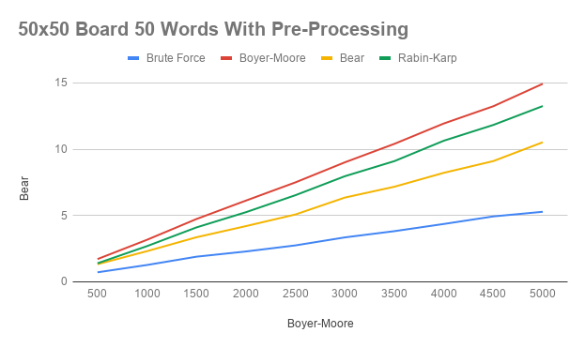
Base Case 50x50 using 50 Words (with Pre-processing)
These Results are with Pre-Processing included in our timed results.
Fastest to slowest in descending order:

Slide 17
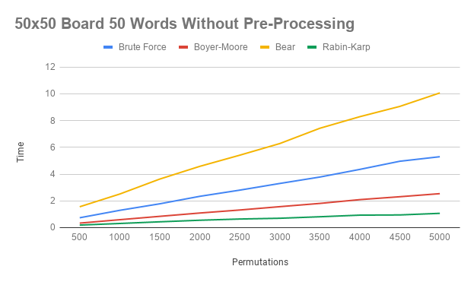
Base Case 50x50 using 50 Words (without Pre-processing)
These Results are with Pre-Processing included in our timed results.

Slide 18
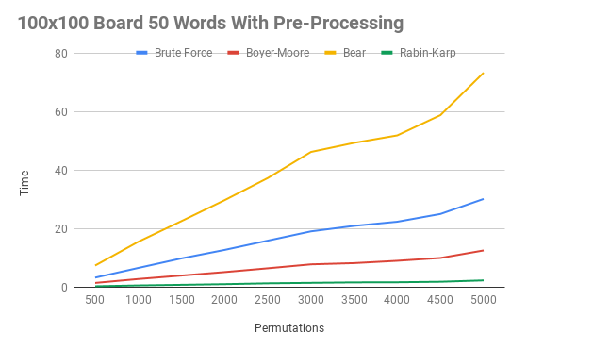
Increased Board Size (with pre-processing)

Slide 19
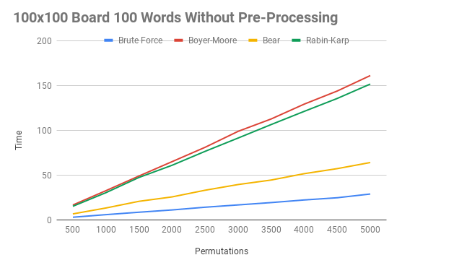
Increased Board Size (without pre-processing)

Slide 20
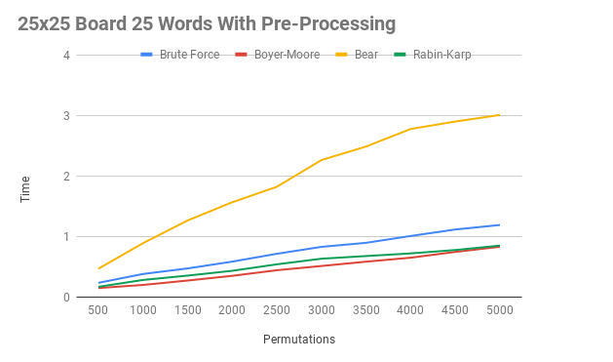
Decreased Board Size (with pre-processing)

Slide 21
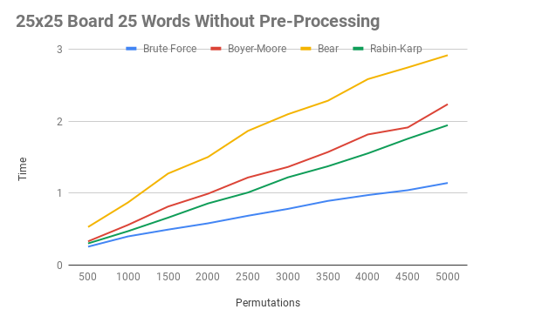
Decreased Board Size (without pre-processing)

Slide 22
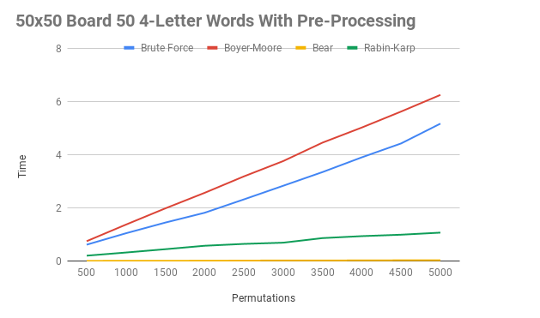
Short Words (with pre-processing)

Slide 23
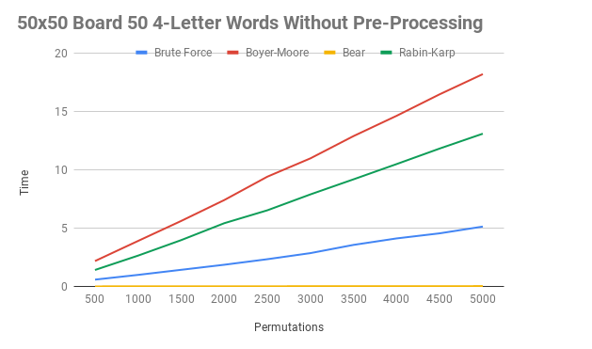
Short Words (without pre-processing)

Slide 24
Conclusion

Slide 25

Questions?

